Slide 1

NetWarden: Mitigating Network Covert Channels while Preserving Performance
Jiarong Xing, Qiao Kang, Ang Chen
Rice University

Slide 2







Motivation: Mitigating network covert channels
Launch code:
1011
Ah! 1011
President
TCP hdr: 1011
Launch code
Code is 1011
H E L L O
H
E
L
L
O
1
0
1
1
Attacker
Secretary
Covert channels:
Storage channels: changing the packet header fields.
Timing channels: changing the timing of packets.

Slide 3


Covert channels are a difficult problem
A malicious packet
Malicious timing
TCP ISN: 1011
H E L L O
H
E
L
L
O
A normal packet
Normal timing
Detection is difficult due to non-determinism
Protocols fields, e.g., TCP initial sequence numbers
Protocol events, e.g., inter-packet gaps
Mitigation is difficult due to high traffic volume
Operate on every packet of Tbps traffic

Slide 4
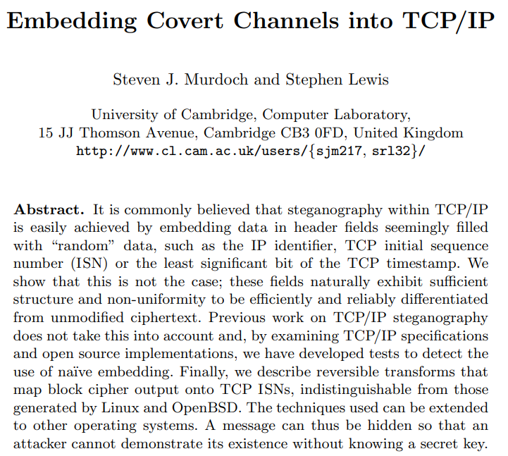
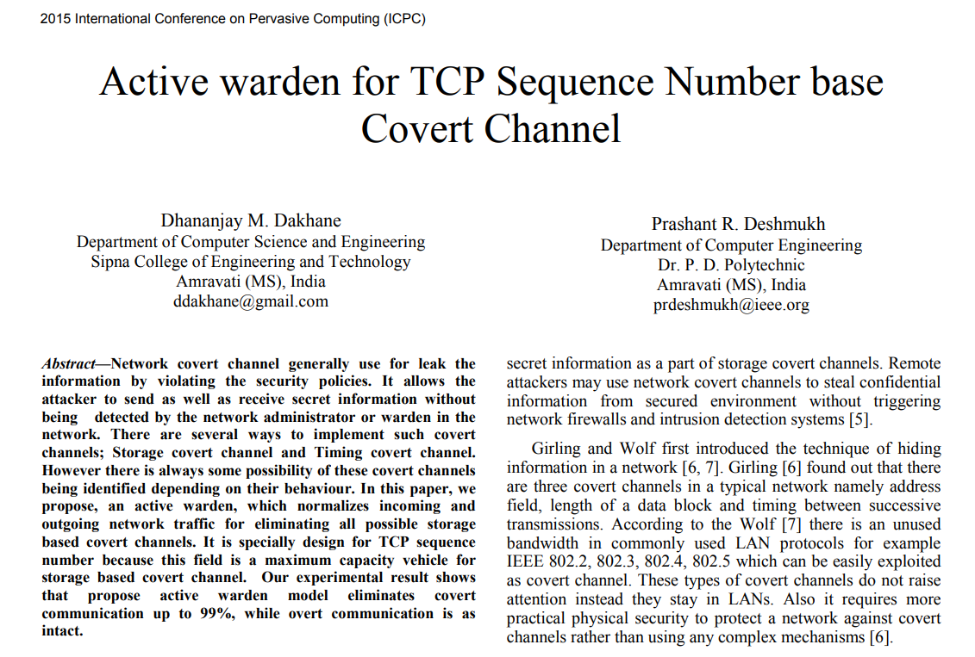
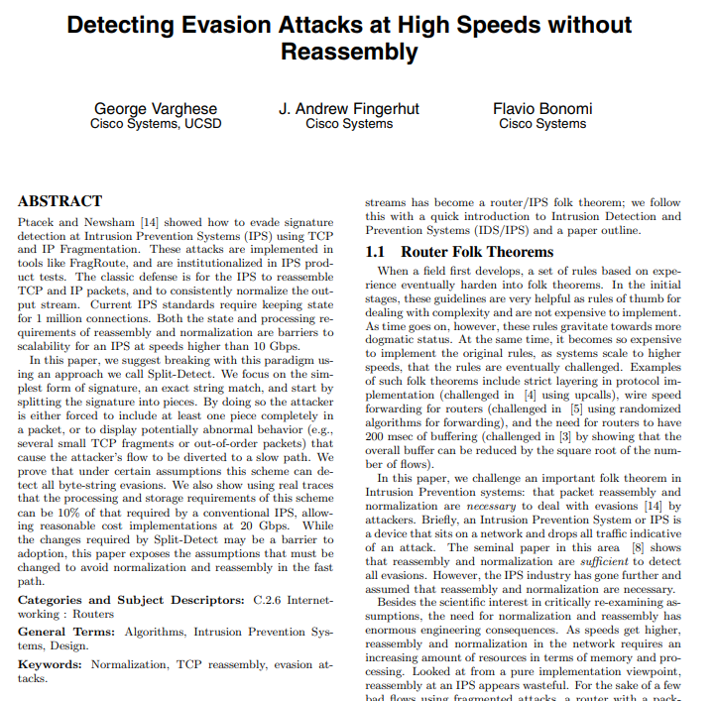
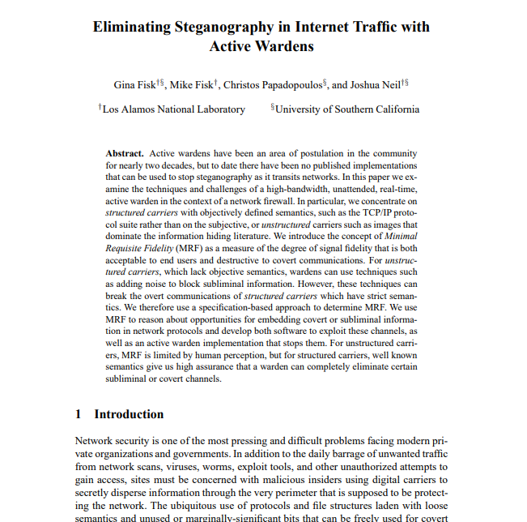
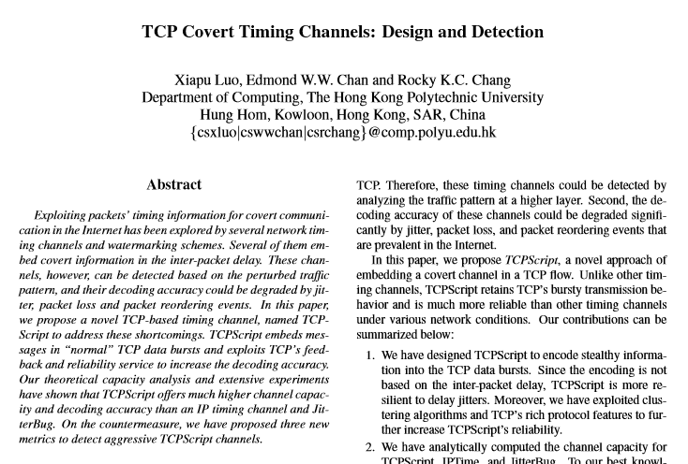
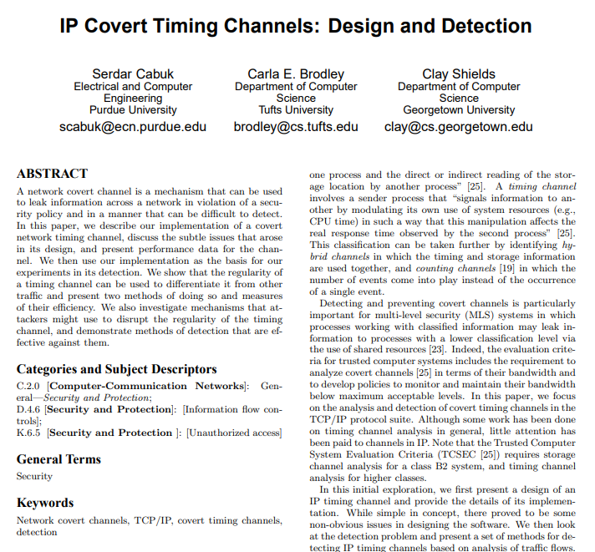
State of the art
With channel:
TCP sender
TCP sender
1
0
1
1
TCP ISN: 1011
replace (+2)
TCP ISN: 1101
H
E
L
L
O
H E L L O
H E L L O
SeqNo = a
replace (+2)
SeqNo = a +2
SeqNo = b
replace (+2)
SeqNo = b +2
1
1
0
1
SeqNo = c
replace (+2)
SeqNo = c +2
H
E
L
L
O
SeqNo = d
replace (+2)
SeqNo = d +2
…
After mitigating:
Many defenses have been proposed:
ISN storage channel:
Add the same offset to TCP sequence numbers
IP timing channel:
Add random delays to destroy original timing

Slide 5

Common problem: Performance penalty
Per-packet operation running in software is very inefficient
Switches have to handle Tbps traffic
Incur extra delay to TCP connections
Many flows are delay sensitive
Not practical for deployment!

Slide 6


Key question
Can we mitigate covert channels
while preserving performance?

Slide 7
New opportunity: Programmable switches
Switch control plane
Programmable
Parser
PCIe bus
Programmable
Deparser
Memory
ALU
Match/
Action
Table
Match/
Action
Table
Stages
Stages
Match/
Action
Table
Programmable switches
Can be programmed in high-level languages (e.g., P4)
Run at linespeed (Tbps)
Widely used in network community:
SilkRoad-Sigcomm’17, Speedlight-Sigcomm’18, Blink-NSDI’19, Contra-NSDI’20, etc.
An ideal candidate for covert channel defenses!

Slide 8




NetWarden: A programmable switch defense
NetWarden
Covert channels
Normal traffic
A programmable switch
NetWarden mitigates covert channels while preserving performance.

Slide 9



Key features
Effective defenses
High throughput
Defend against a wide range
of covert channels
~100Gbps per switch port
NetWarden
Performance preservation
Great transparency
< 1% performance deviation
Totally transparent to end hosts

Slide 10

Outline
Motivation: Mitigating network covert channels
State of the art: Performance penalty
Approach: NetWarden
NetWarden design
Challenge #1: Limited programming model
Challenge #2: Performance preservation
Evaluation
Conclusion

Slide 11
Challenge #1: Limited programming model
Solution: hardware/software co-design principle.

Slide 12


Programmable switch anatomy
Switch control plane
PCIe bus
Memory
ALU
Match/
Action
Table
Match/
Action
Table
Stages
Stages
Match/
Action
Table
Data plane
Header modification, ns timestamp, per-flow state, line speed
Limited memory, limited arithmetic computation
Control plane
Abundant memory, complex arithmetic computation
Software speed
Complementary!

Slide 13
Applying the hardware/software co-design principle
Switch control plane
Computation: Batch operations
Memory: Growing state
Minimize crosstalk
Computation: Per-packet operations
Memory: Constant state
Switch data plane

Slide 14





Applying the hardware/software co-design principle
Switch control plane
Packet caching
Statistical tests
RTT
measurement
Per-flow state
maintenance
IPD
maintenance
Header
modification
Switch data plane

Slide 15
Challenge #2: Performance preservation
data
data
ACK
ACK
data
data
ACK
data
ACK
Extra delay
Problem: Existing mitigations incur performance loss.
Takeaway: Create the illusion of the same RTT for the sender.

Slide 16


Solution: Performance boosters
ACK booster
Receiving window booster
ACK booster
Maintain the same RTT by generating ACK packets in advance.
Receiving window booster
Send more data per RTT by enlarging the receiving window size.

Slide 17
Performance preservation: ACK booster
①
③
⑤
Retransmission
②
④
NetWarden
Creates the illusion of the same RTT as perceived by the sender.

Slide 18
Outline
Motivation: Mitigating network covert channels
State of the art: Performance penalty
Approach: NetWarden
NetWarden design
Challenge #1: Limited programming model
Challenge #2: Performance preservation
Evaluation
Conclusion

Slide 19
Evaluation setup
NetWarden prototype:
Runs in Tofino Wedge 100BF-32X switch.
2500 LoC of P4 + 3000 LoC of C+Python
Threat model:
A compromised server + a trusted P4 switch running NetWarden
Leak a 2048-bit RSA key via covert channel.
Real world applications:
Apache servers, FTP servers, Nodejs servers
Baseline:
No defense: No covert channel defenses are deployed.
Naïve defense: Covert channel defenses without performance preservation

Slide 20
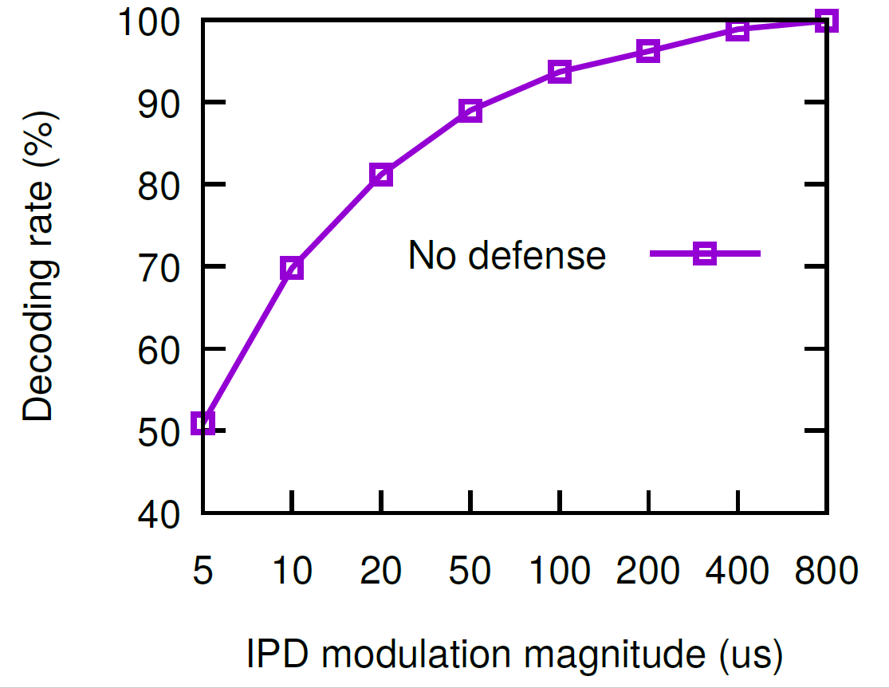
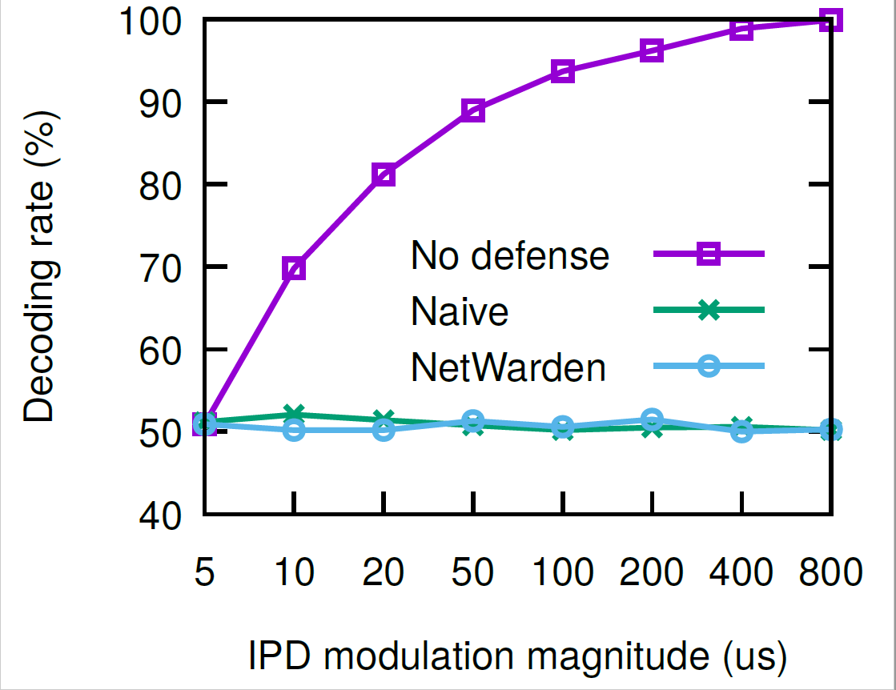
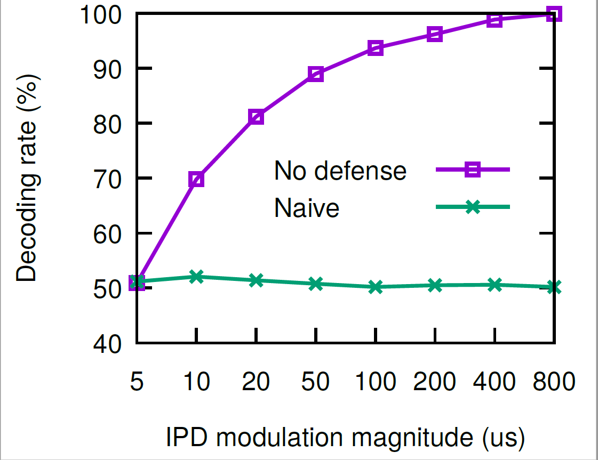
How effective is NetWarden in covert channels mitigation ?
Naïve defense: renders decoding to a random guess.
NetWarden: very close to a random guess.
NetWarden can mitigate covert channels effectively.

Slide 21
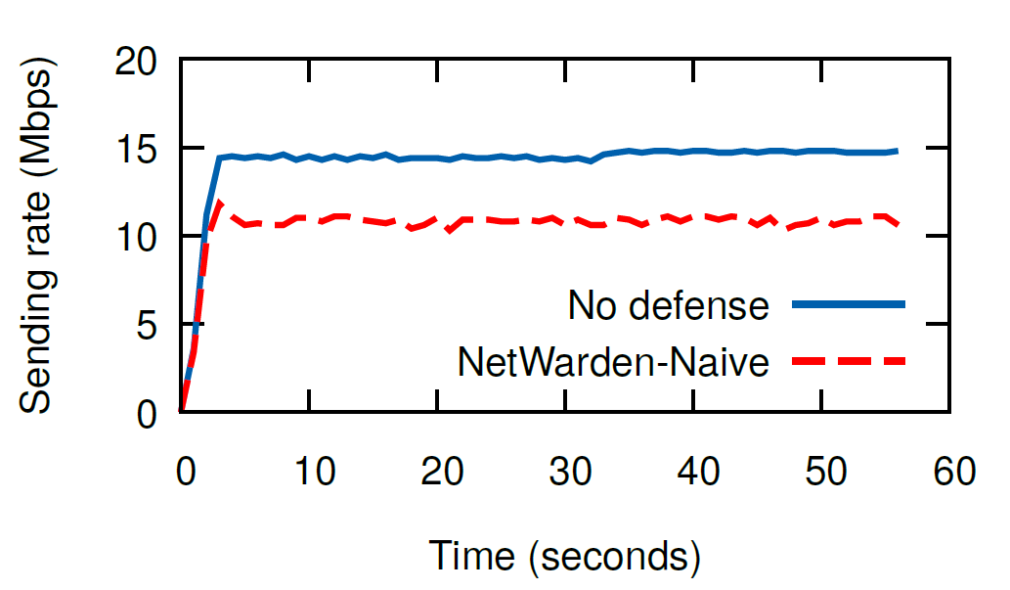
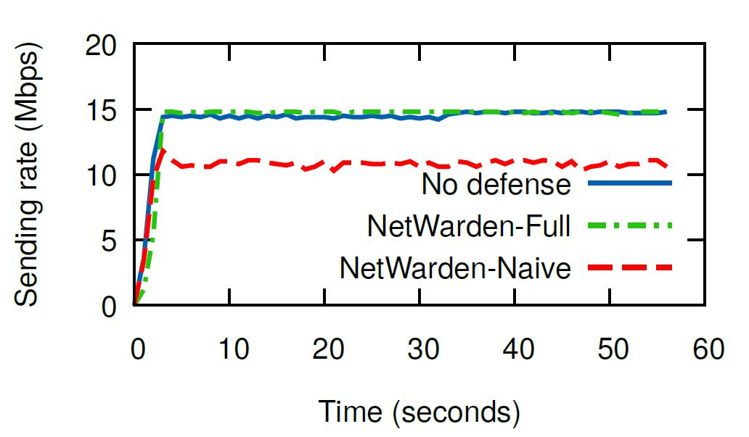
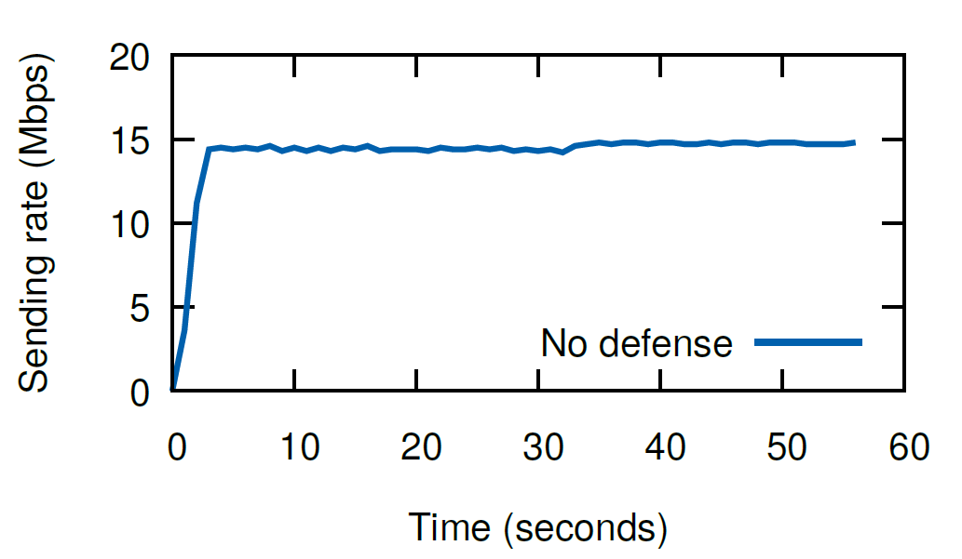
How well does NetWarden preserve performance?
No defense
NetWarden
Naive
No defense
Naive
Naïve defense incurs 25% performance penalty.
NetWarden only has 1% performance deviation.
NetWarden can mitigate covert channels with minimal performance loss.

Slide 22






See more evaluation results in our paper
System scalability
System overhead
Different TCP variants
Complex Applications
Self-defense techniques

Slide 23
Outline
Motivation: Mitigating network covert channels
State of the art: Performance penalty
Approach: NetWarden
NetWarden design
Challenge #1: Limited programming model
Challenge #2: Performance preservation
Evaluation
Conclusion

Slide 24
Conclusion
Motivation: Mitigating network covert channels
Key limitation of existing approaches:
Performance penalty
Our approach: NetWarden
Principles of hardware/software co-design
Efficient defenses
Performance preservation
Evaluation:
Mitigates covert channels with minimum performance loss!
Source code: https://github.com/jiarong0907/NetWarden
Looking for internship in 2021 summer!
Questions?

